Slide 1
Floorplanning
Workshop Session 4
Presented by
Hafiz Wajeh ul Hasan

Slide 2
Design.v, Design.sdc, Std_cells.lef, Std_cells.lib
Input
Synthesis
Yosys, OpenSTA
Design_gate_level_netlist.v
Output
Design_gate_level_netlist.v, macro.lef, macro.cfg
Input
Floorplanning/Power Network
init_fp, ioplacer, pdn
Floorplan.def
Output
Floorplan.def
Input
Placement
RePLace,OpenDP
Placement.def
Output
Open-source EDA Tools
Design_gate_level_netlist.v, Placement.def
Input
CTS
TritonCTS
CTS.def, CTS_netlist.v
Output
Input
Routing
FastRoute, TritonRoute
CTS.def
Routing.def
Output
Input
RC Extraction
SPEF-Extractor
Routing.def
Design.spef
Output
Input
GDS Generation
Magic
Input
Routing.def
Output
Output
Design.gds, Design.lef
Input
Physical Verification
APR Step
Design.gds
Magic
EDA Tool

Slide 3
Contents
Floorplanning
Row Formation
Number of Rows
Height of Rows
Core Utilization
Aspect Ratio
Power Distribution Network
Power Connections
LAB PRACTICE

Slide 4
Floorplanning
What is Floorplanning?
Defining the area of the chip
Die area
Core area
Formation of rows
Height of rows
Metaphorically speaking,
Acquiring the land/plot to build the house

Slide 5
Die Area vs Core Area
IO PAD AREA
IO pads where pins are connected
CORE AREA
IO PAD AREA
IO PAD AREA
Die Area
IO pad Area + Core Area
IO PAD AREA
Core Area where logic bocks are placed

Slide 6
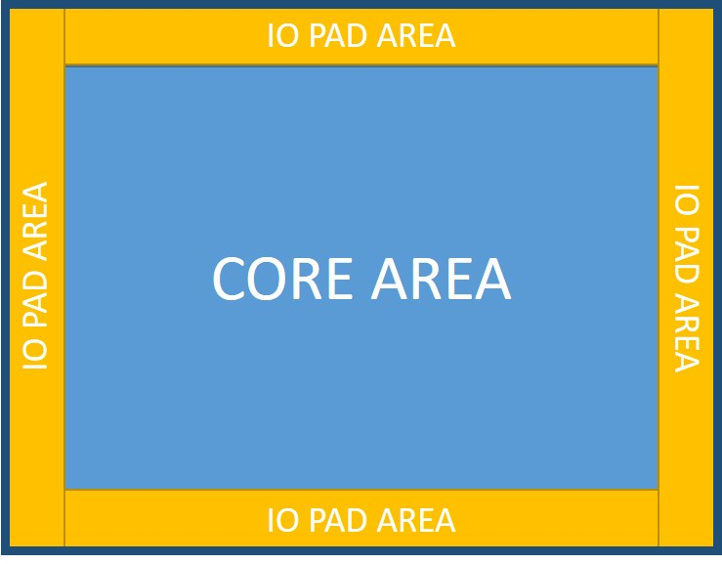
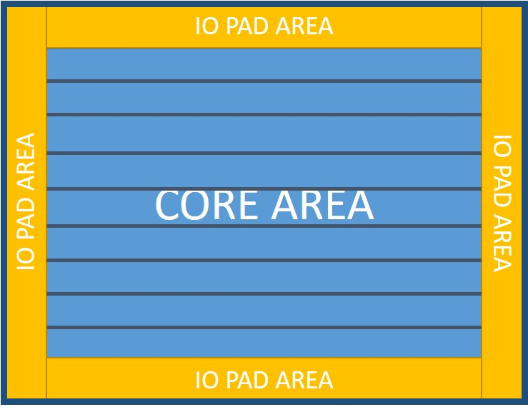
Row Formation
Formation of rows is carried out after deciding the area
Why Rows?
How are the rows decided?

Slide 7

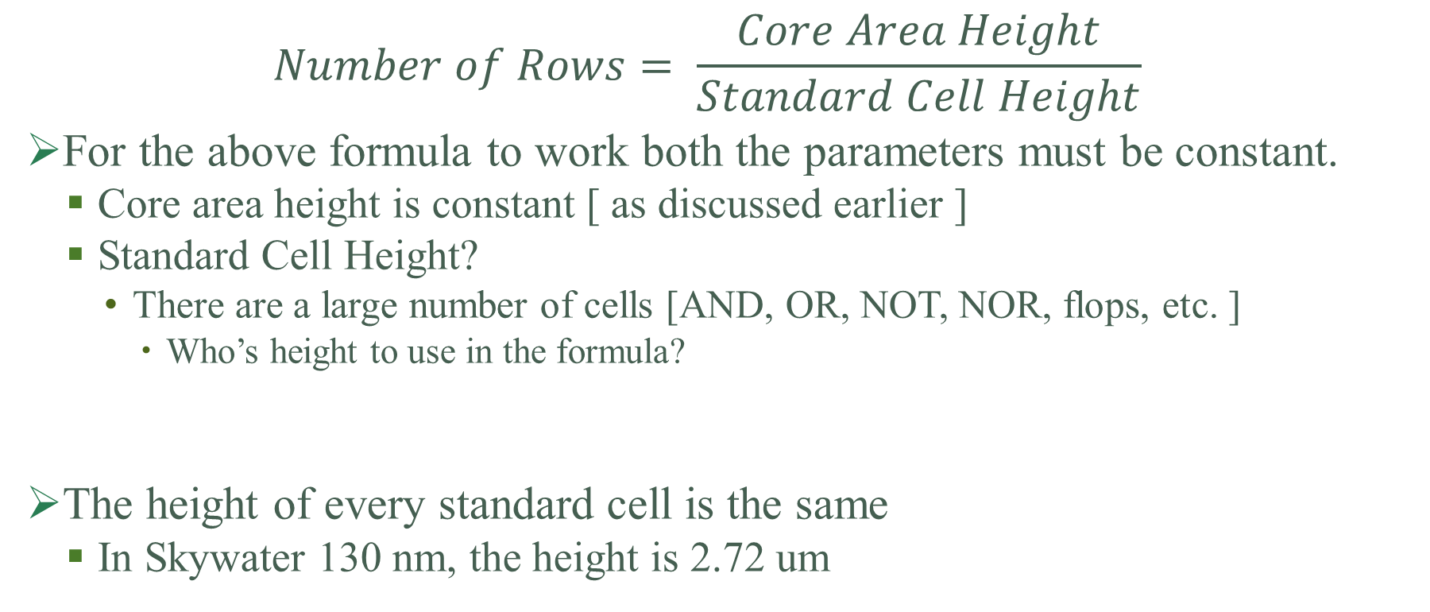
Row Formation
$$Number of Rows= \frac{Core Area Height}{Standard Cell Height}$$
For the above formula to work both the parameters must be constant.
Core area height is constant [ as discussed earlier ]
Standard Cell Height?
There are a large number of cells [AND, OR, NOT, NOR, flops, etc. ]
Who’s height to use in the formula?
The height of every standard cell is the same
In Skywater 130 nm, the height is 2.72 um

Slide 8
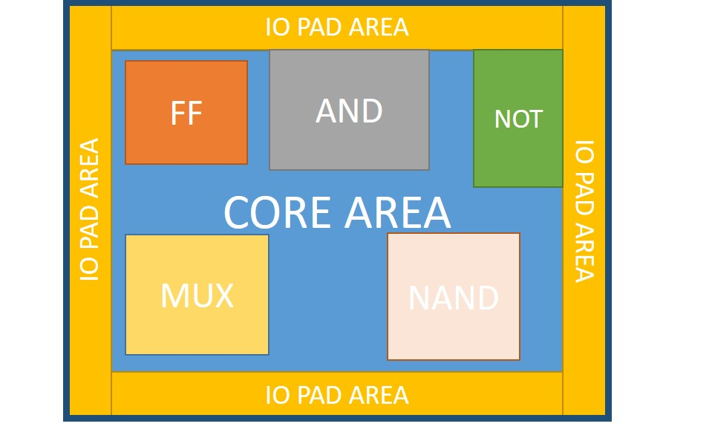
Core Utilization
$Core Utilization=\frac{Standard Cells Area+ Macros Area }{Total Core Area }$
Core Area with 100 % Utilization
Core Area with less than100 % Utilization
Core Area
IO PAD AREA
Standard Cells
CORE AREA
FF
AND
NOT
FF
AND
NOT
IO PAD AREA
MUX
NOR
IO PAD AREA
NAND
MUX
NOR
NAND
8
IO PAD AREA

Slide 9
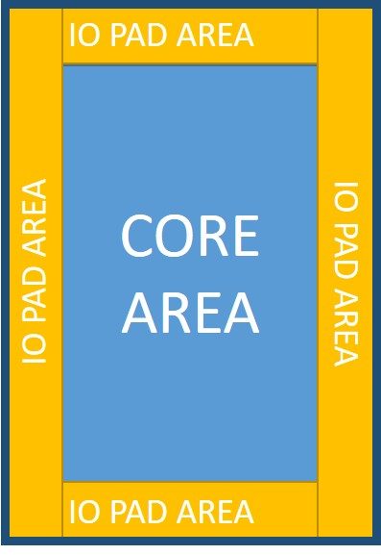
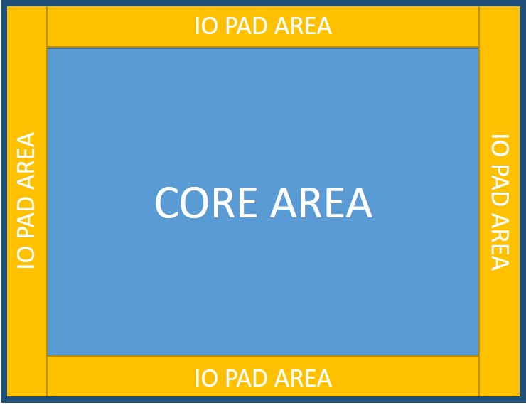
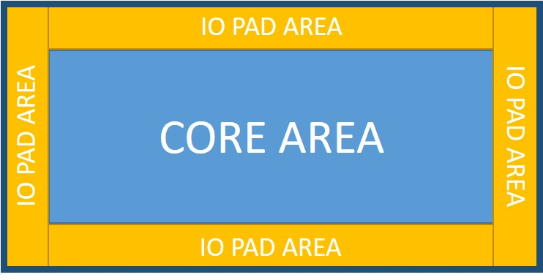

Aspect Ratio
$$Aspect Ratio=\frac{Height of Core }{Width of Core }$$
Aspect Ratio = 1
Aspect Ratio = 0.5
Aspect Ratio = 2

Slide 10
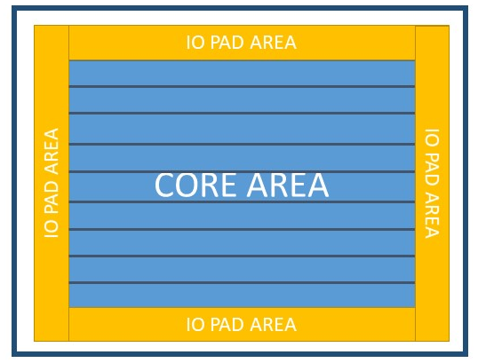
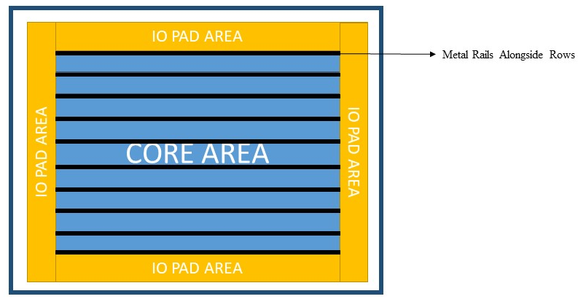
Power Distribution Network
PDN distributes the power from the external source to the internal standard cells.
The aim is to provide power to the standard cells without the voltage drop
The process starts with inserting metal rails along the rows

Slide 11
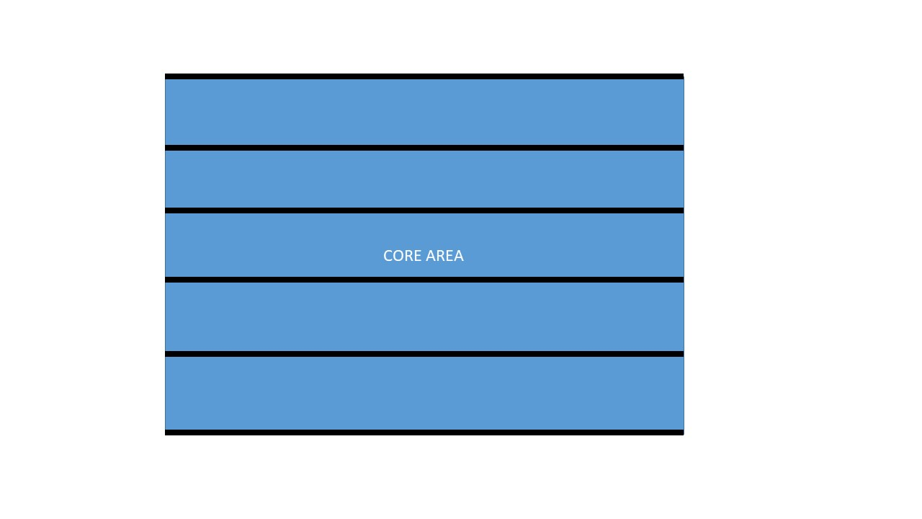

Slide 12
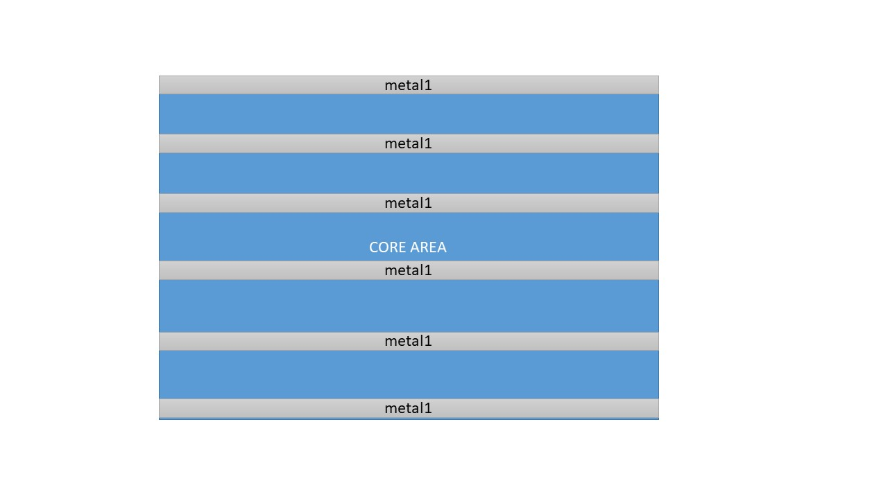
Power
We start by placing the metal rows
Note that each layer is either power or ground
Ground
Power
Ground
Power
Ground

Slide 13
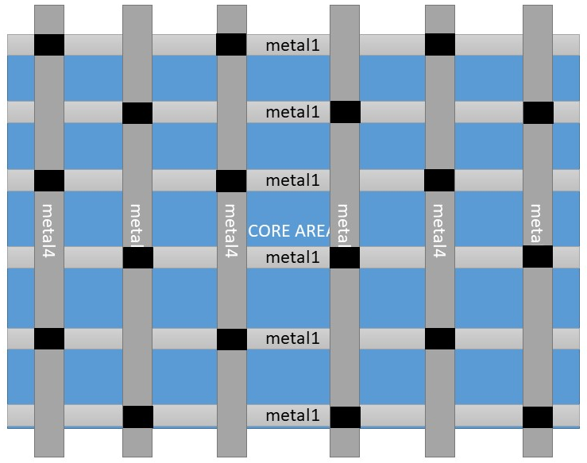
offset
pitch
Power
Vertical straps are then inserted
Power and ground are separated and they don’t overlap
Ground
Power
Ground
Pitch: The center to center between 2 adjacent straps
Offset: The distance from the edge of the core to the first metal layer
Power
Ground

Slide 14
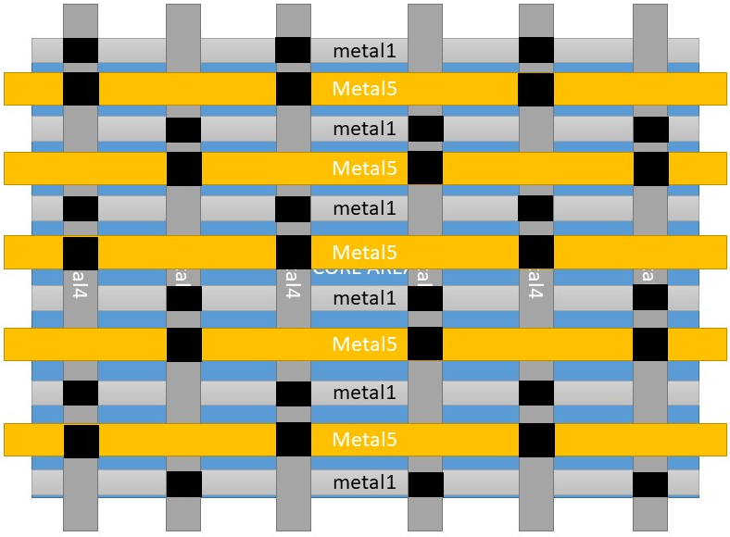
Power
Horizontal straps are then inserted
Power and ground are separated and they don’t overlap
Ground
Power
Ground
Power
Ground
The complete power grid but without power ring

Slide 15
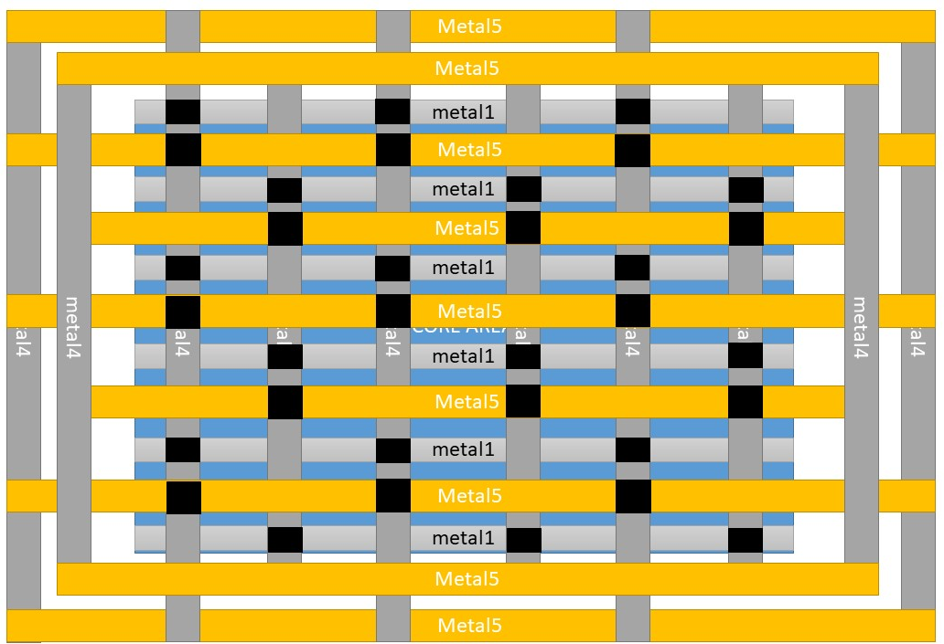
The complete power grid with power rings

Slide 16
Conclusion
The area and number of rows are fixed at the floorplan step
Core utilization and aspect ratio are used when the die area is not defined
Power distribution network follows:
Metal rails
Vertical Strips
Horizontal Strips
Power Ring

Slide 17
LAB PRACTICE

